Slide 1

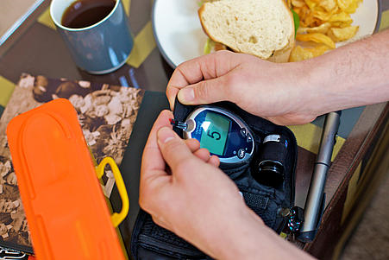

National Diabetes Audit, 2015-2016
Report 1: Care Processes and Treatment Targets
England and Wales
31 January 2017

Slide 2




Prepared in collaboration with:
 | The Healthcare Quality Improvement Partnership (HQIP). The National Diabetes Audit is commissioned by the Healthcare Quality Improvement Partnership (HQIP) as part of the National Clinical Audit Programme (NCA). HQIP is led by a consortium of the Academy of Medical Royal Colleges, the Royal College of Nursing and National Voices. Its aim is to promote quality improvement, and in particular to increase the impact that clinical audit has on healthcare quality in England and Wales. HQIP holds the contract to manage and develop the NCA Programme, comprising more than 30 clinical audits that cover care provided to people with a wide range of medical, surgical and mental health conditions. The programme is funded by NHS England, the Welsh Government and, with some individual audits, also funded by the Health Department of the Scottish Government, DHSSPS Northern Ireland and the Channel Islands.
 | NHS Digital is the new name for the Health and Social Care Information Centre. NHS Digital managed the publication of the 2015-2016 annual report.
 | Diabetes UK is the largest organisation in the UK working for people with diabetes, funding research, campaigning and helping people live with the condition.
Supported by:
 | The national cardiovascular intelligence network (NCVIN) is a partnership of leading national cardiovascular organisations which analyses information and data and turns it into meaningful timely health intelligence for commissioners, policy makers, clinicians and health professionals to improve services and outcomes.

Slide 3
Introduction
The National Diabetes Audit (NDA) provides a comprehensive view of diabetes care in England and Wales and measures the effectiveness of diabetes healthcare against NICE Clinical Guidelines and NICE Quality Standards^{1,2}.
GP practice and specialist service level information accompanies this report and can be found here.
The Core National Diabetes Audit (NDA) answers four key questions:
Is everyone with diabetes diagnosed and recorded on a practice diabetes register?
What percentage of people registered with diabetes received the nine NICE key processes of diabetes care?
What percentage of people registered with diabetes achieved NICE defined treatment targets for glucose control, blood pressure and blood cholesterol?
For people with registered diabetes what are the rates of acute and long term complications (disease outcomes)?

Slide 4
Aims and Objectives
The NDA supports improvement in the quality of Diabetes care by enabling participating NHS services and organisations to:
  Assess local practice against NICE guidelines
  Compare their care and care outcomes with similar services and organisations
  Identify gaps or shortfalls that are priorities for improvement
  Identify and share best practice
  Provide comprehensive national pictures of diabetes care and outcomes in England and Wales
A Quality Improvement Toolkit has been developed in collaboration with the RCGP http://www.rcgp.org.uk/clinical-and-research/toolkits/quality-improvement-toolkit-for-diabetes-care.aspx

Slide 5
Key Findings
Participation
  Participation increased to 82.4 per cent from 57.3 per cent in 2014-15
Annual Care Processes
  The 2013-14 drop in Body Mass Index (BMI) checks and the 2014-15 drop in Urine Albumin to Creatinine Ratio (UACR) measurement (the check for early kidney disease) have not recovered
  Even when case-mix adjusted (banded) the variation is striking
Structured Education
  The progressive rise in offers continues
  Recording of attendance is still inconsistent
Achievement of the Treatment Targets (HbA1c, BP, Cholesterol)
  Variation is notable among Clinical Commissioning Groups (CCGs) and Local Health Boards (LHBs), specialist and GP services for both Type 1 and Type 2 and other diabetes
  Variation is not explained by case-mix
  Those aged under 65 do worst (both Type 1 and Type 2 and other)
Learning Disability (LD)
  People with diabetes who have a LD have similar care process and treatment target results to their peers without a learning disability.

Slide 6
Recommendations
Structured education providers and their commissioners should follow the recently agreed communication guidance to improve recording of structured education attendance (link to guidance).
GP and specialist services and CCGs/LHBs should use relevant parts of this report and the accompanying local level information to compare themselves to similar services and identify areas for improvement and implement local action plans.
All services seek new approaches to diabetes service delivery for those aged under 65 to narrow the gap between them and older people.
People with diabetes to review the results for their practice or specialist service and support any improvement initiatives.

Slide 7

National Diabetes Audit 2015-2016
Is everyone with diabetes diagnosed and recorded on a practice diabetes register?

Slide 8
Registrations
Table 1: Diabetes registrations and prevalence for all diabetes by source, 2015-2016
England and Wales
Audit Year | Total number of registrations | Percentage of the population* | Registrations from primary care | Registrations from specialist care where there is no corresponding GP record**
2015-2016 | 2,721,292 | 6.4% | 2,646,701 | 74,591
*Population is the participating GP practice list size
**This is likely to be where a GP practice has not participated in the National Diabetes Audit
The National Cardiovascular Intelligence Network (NCVIN) have recently published a diabetes prevalence model for local authorities and CCGs. These estimate the total diagnosed and undiagnosed for people aged 16 and over in England and can be found here:
www.yhpho.org.uk/resource/view.aspx?RID=154049

Slide 9
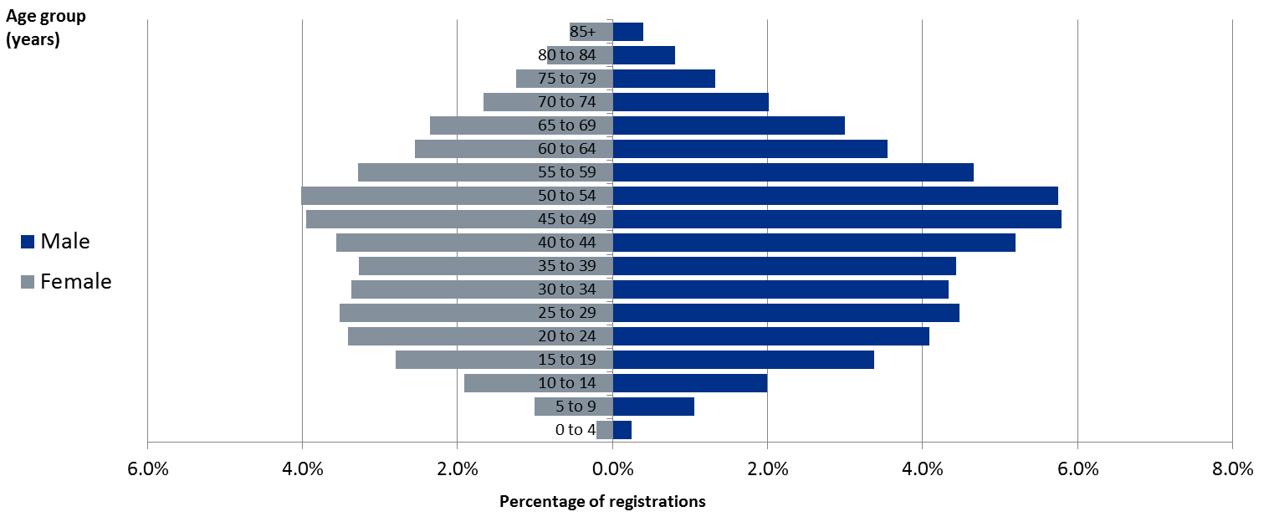
Registrations - Characteristics
There is a higher proportion of males in those with Type 1 diabetes
Figure 1: Age and gender of patients with Type 1 diabetes in England and Wales, 2015-2016

Slide 10
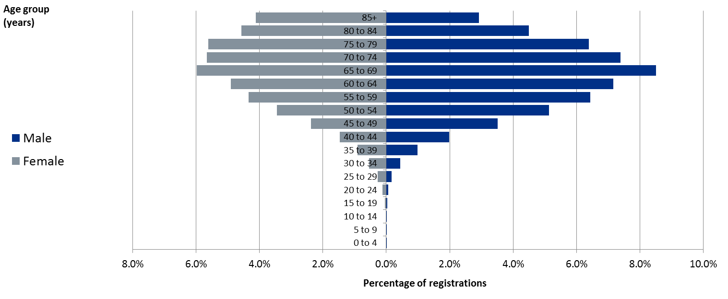
Registrations - Characteristics
People with Type 2 diabetes are older than those with Type 1 diabetes
Figure 2: Age and gender of patients with Type 2 and other diabetes in England and Wales, 2015-2016

Slide 11
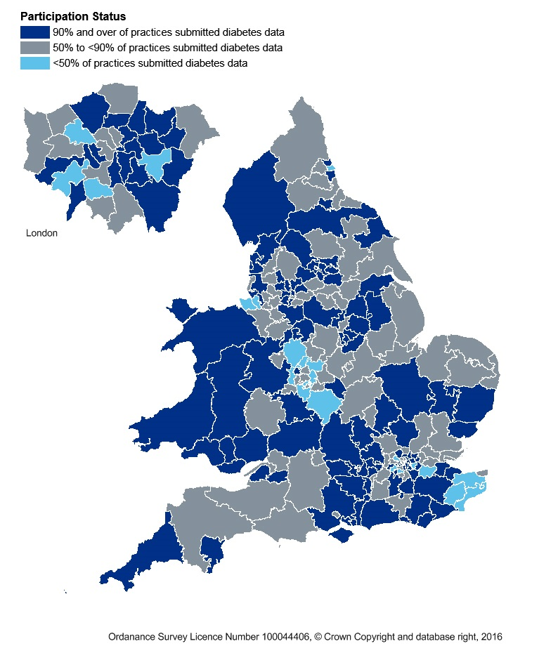
Participation
Participation increased in 2015-2016 to 82.4 per cent in England and Wales.
The map shows that participation was less than 50 per cent in 16 CCGs and caution should be borne when looking at the information for these localities.
For more information on the level of participation in 2015-16 by CCG and LHB please see the participation report.
A dashboard showing participation over the last 3 years for CCGs and LHBs can be found here.

Slide 12
National Diabetes Audit 2015-2016
What percentage of people registered with diabetes received the NICE key processes of diabetes care?

Slide 13
Care Processes
All people with diabetes aged 12 years and over should receive all of the nine NICE recommended care processes^{1,2} and attend a structured education programme when diagnosed.
Nine Annual Care Processes for all people with diabetes aged 12 and over
Responsibility of Diabetes Care providers (included in the NDA 8 Care Processes)
1. HbA1c (blood test for glucose control) | 5. Urine Albumin/Creatinine Ratio (urine test for kidney function)
2. Blood Pressure (measurement for cardiovascular risk) | 6. Foot Risk Surveillance (foot examination for foot ulcer risk)
3. Serum Cholesterol (blood test for cardiovascular risk) | 7. Body Mass Index (measurement for cardiovascular risk)
4. Serum Creatinine (blood test for kidney function) | 8. Smoking History (question for cardiovascular risk)
Responsibility of NHS Diabetes Eye Screening (screening register drawn from practices)
9. Digital Retinal Screening (photographic eye test for eye risk)
1,2. Please see full list of footnotes in the definitions and footnote section

Slide 14
Care Processes – Time Series
Key Finding
The 2013-14 drop in BMI checks and the 2014-15 drop in urine albumin checks have not recovered in 2015-16.
Fewer people with Type 1 than with Type 2 and other diabetes receive their annual checks.
Table 2: Percentage of people with diabetes receiving NICE recommended care processes by care process, diabetes type and audit year
England and Wales
 | Type 1 |  |  |  |  |  | Type 2 and other³
 | 2010-11 | 2011-12 | 2012-13 | 2013-14 | 2014-15 | 2015-16 | 2010-11 | 2011-12 | 2012-13 | 2013-14 | 2014-15 | 2015-16
HbA1c | 86.0 | 83.0 | 79.8 | 80.9 | 83.2 | 83.7 | 93.1 | 90.9 | 93.1 | 93.5 | 94.8 | 95.0
Blood pressure | 88.7 | 88.4 | 87.7 | 87.0 | 89.0 | 89.1 | 95.7 | 95.6 | 95.4 | 94.9 | 96.1 | 95.7
Cholesterol | 78.8 | 77.8 | 77.3 | 77.4 | 78.7 | 79.1 | 92.8 | 92.1 | 91.9 | 92.4 | 92.8 | 92.7
Serum creatinine | 81.2 | 81.1 | 80.3 | 78.8 | 80.5 | 81.5 | 93.5 | 93.5 | 93.2 | 93.4 | 94.5 | 94.7
Urine albumin* | 58.4 | 59.2 | 56.5 | 63.9 | 55.9 | 50.2 | 76.7 | 77.5 | 74.7 | 84.4 | 74.6 | 66.7
Foot surveillance | 71.5 | 72.8 | 71.5 | 70.7 | 72.4 | 72.9 | 85.5 | 86.4 | 85.8 | 86.2 | 86.7 | 86.7
BMI | 83.4 | 83.7 | 83.3 | 76.8 | 74.9 | 75.2 | 90.5 | 90.9 | 90.9 | 85.7 | 83.1 | 82.7
Smoking | 78.6 | 79.0 | 79.2 | 77.4 | 77.9 | 78.5 | 85.4 | 85.7 | 86.3 | 85.5 | 85.2 | 85.2
Eight care processes ⁴ | 43.3 | 43.2 | 40.8 | 44.5 | 38.7 | 36.5 | 62.3 | 62.1 | 61.2 | 67.6 | 58.7 | 53.7
* There is a ‘health warning’ regarding the screening test for early kidney disease (Urine Albumin Creatinine Ratio, UACR) prior to 2013-14; please see the NDA Data Quality statement
3,4. Please see full list of footnotes in the definitions and footnote section.

Slide 15
Care Processes – By Age
Key Finding
Younger people with either Type 1 or Type 2 and other diabetes are less likely to receive their annual diabetes checks than their older counterparts.
Figure 3: Percentage of all people with diabetes receiving all eight NICE recommended care processes⁴ by age and diabetes type, 2015-2016
England and Wales
4. Please see full list of footnotes in the definitions and footnote section

Slide 16
Care Processes – Learning Disabilities
Key Finding
People with learning disability who have Type 1 diabetes are more likely to receive their annual checks whilst those with Type 2 and other diabetes are less likely to receive them compared to the general diabetic population.
Figure 4: Percentage of all people with diabetes receiving all eight NICE recommended care processes⁴ by diabetes type, and learning disability, standardised by age and sex, 2015-2016
England and Wales
* For more information on people with diabetes with a learning disability, please see supplementary slides found here
4. Please see full list of footnotes in the definitions and footnote section

Slide 17
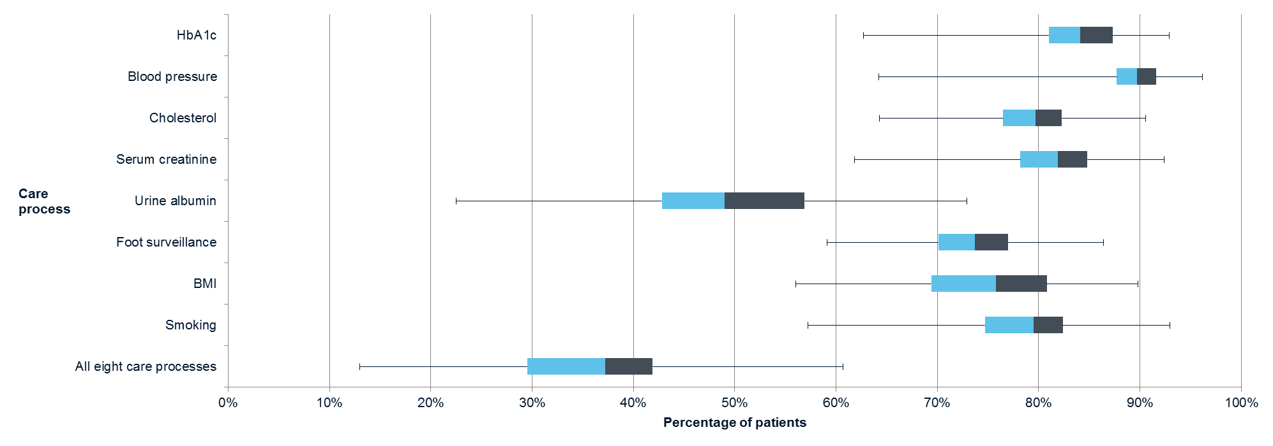
Care Processes - Locality Variation, Type 1
Key Finding
The striking variation at locality level is evident and can also be seen between similar specialist services.
Figure 5: The range of CCG/LHB care process completion for people with Type 1 diabetes, 2015-2016
England and Wales
GP practice and specialist service level information accompanies this report and can be found here.
Care processes are presented with case-mix adjusted bandings and show whether a service is achieving care process delivery levels expected for their patient population. The bandings take into account age, gender, ethnicity, duration of diabetes and social deprivation.

Slide 18
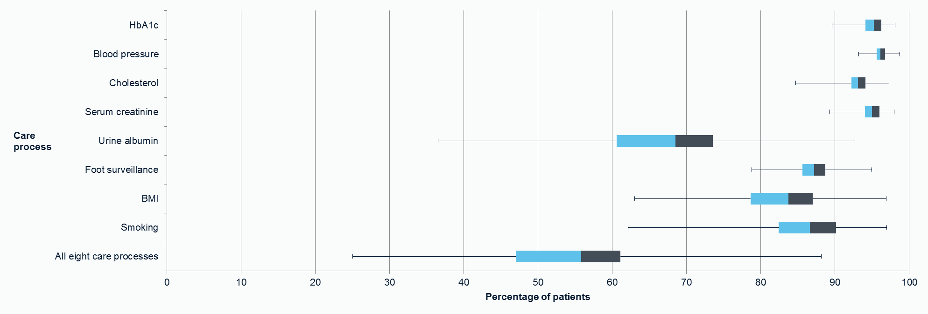
Care Processes - Locality Variation, Type 2
Key Finding
The striking variation at locality level is evident and can also be seen between similar General Practices.
Figure 6: The range of CCG/LHB care process completion for people with Type 2 and other diabetes, 2015-2016
England and Wales
GP practice and specialist service level information accompanies this report and can be found here.
Care processes are presented with case-mix adjusted bandings and show whether a service is achieving care process delivery levels expected for their patient population. The bandings take into account age, gender, ethnicity, duration of diabetes and social deprivation.

Slide 19
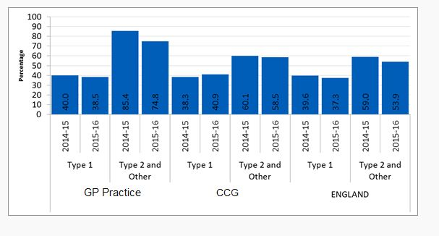
Care Processes – CCG/LHB information
This slide is for CCG/LHB or GP Practices to insert CCG/LHB or GP level information from the GP level excel spreadsheet.
For example:
You may choose to show Figure 3 from the CareProcessCompletion tab in the CCG Level spreadsheet. This will illustrate your chosen GP practice performance compared to the CCG and England figures.

Slide 20
Care Processes – Comments
The annual review¹ is the essential foundation for all effective diabetes care in both GP and specialist services.
There are many opportunities for improvement such as:
  Between services to reduce the striking variation
  Services for young people with both Type 1 and Type 2 and other diabetes
  Services for people with Type 1 diabetes
  Services for people with Type 2 and other diabetes who have a learning disability
Recommendations
Commissioners:
  Support services that show they have challenges providing good outcomes
  Support trials of new approaches to care for younger people
Specialist and GP services:
  Benchmark against their peers using both local and national data
  Choose a priority for improvement
  Use the NDA QI guides to identify opportunities
  Implement improvement plans
1. Please see full list of footnotes in the definitions and footnote section

Slide 21
Structured Education - Offered
Key Findings
Timely offers of structured education have improved over the last three years
Of those offered education, the majority are offered within one year of diagnosis
Figure 7: Percentage of people diagnosed with diabetes that were offered structured education, by year of diagnosis and diabetes type, 2015-16
England and Wales

Slide 22
Structured Education - Attended
Key Findings
There are good reasons to believe that attendance is much higher than recorded.
The decrease in attendance more recently should be addressed through the dissemination of supporting guidance for data recording to CCGs who commission education providers.
Figure 8: Percentage of people diagnosed with diabetes that attended structured education, by year of diagnosis and diabetes type, 2015-16
England and Wales
Attendance at structured education forms one of the indicators in the CCG improvement and assessment framework 2016/17.

Slide 23
Structured Education - Comment
The NHS sometimes seems to underestimate, or undervalue, the provision of structured education for people with diabetes.
Diabetes is a lifelong disorder with no periods of remission. Treatment demands are all day, every day.
People with diabetes rarely spend more than two to three hours per year with a healthcare professional, and for the remaining 8,757 hours they must manage their diabetes themselves. They need the knowledge and skills to do this.
Recommendations
Commissioners should ensure that Type 1 and Type 2 diabetes structured education programmes can be easily accessed in line with NICE guidelines.
GPs and specialists continue to offer, advocate and check attendance for their patients.
Education providers communicate attendance and completion reliably back to GPs and specialists.

Slide 24
Structured Education – A View Point
Chris, has Type 1 diabetes, 59 years old – attended a DAFNE course
To stay healthy it’s really important for me to understand my diabetes especially when newly diagnosed. During my education sessions I learnt how to manage my condition, but also, just as importantly, I was able to talk with other diabetics and I was able to appreciate that I wasn’t alone.
It’s really important that the course providers record attendance properly because then we will know that more and more of us are better informed about our diabetes.

Slide 25
National Diabetes Audit 2015-2016
What percentage of people registered with diabetes achieved the NICE defined treatment targets for glucose control, blood pressure and blood cholesterol?

Slide 26
Treatment Targets
NICE recommends treatment targets for HbA1c (glucose control), blood pressure and serum cholesterol:
Target HbA1c reduces the risk of all diabetic complications.
Target blood pressure reduces the risk of vascular complications and reduces the progression of eye disease and kidney failure.
Target cholesterol reduces the risk of vascular complications.

Slide 27
Treatment Target – Time Series
Key Findings
The last six years have seen improvements in all 3 treatment target achievement in both Type 1 (1.6 percentage points) and Type 2 and other diabetes (5.1 percentage points).
Recent improvements in blood pressure target achievement (Type 1 & Type 2 and other) and glucose control (Type 1) have been sustained.
Glucose control and cholesterol control targets are much less often achieved in Type 1 diabetes.
Table 3: Percentage of people with diabetes achieving their treatment targets by diabetes type and audit year
England and Wales
 | Type 1 |  |  |  |  |  | Type 2 and other³
 | 2010-11 | 2011-12 | 2012-13 | 2013-14 | 2014-15 | 2015-16 | 2010-11 | 2011-12 | 2012-13 | 2013-14 | 2014-15 | 2015-16
HbA1_{c} < 58 mmol/mol | 28.1 | 27.0 | 27.2 | 29.4 | 29.9 | 29.2 | 66.5 | 65.8 | 64.9 | 66.8 | 66.1 | 65.7
Blood pressure < 140/80* | 68.8 | 72.2 | 73.4 | 76.4 | 76.4 | 74.2 | 61.4 | 66.6 | 68.6 | 73.6 | 74.2 | 73.6
Cholesterol < 5mmol/L | 72.0 | 71.1 | 70.2 | 71.5 | 71.3 | 70.8 | 78.0 | 77.4 | 76.7 | 77.8 | 77.5 | 77.1
Meeting all three treatment targets | 16.5 | 16.5 | 16.1 | 18.6 | 18.9 | 18.1 | 35.1 | 37.4 | 37.3 | 41.4 | 41.0 | 40.2
3,4. Please see full list of footnotes in the definitions and footnote section

Slide 28
Treatment Target – By Age
Key Finding
Younger people with either Type 1 or Type 2 and other diabetes are less likely to achieve all three treatment targets than their older counterparts. This is primarily due to poorer glucose and cholesterol control in those aged under 65 years.
Figure 9: Percentage of all people with diabetes achieving all three treatment targets by age and diabetes type, 2015-2016
England and Wales
Please see the supporting information for charts showing this information for each of the targets separately

Slide 29
Treatment Targets – Learning disability
Key Finding
People with a learning disability who have either Type 1 or Type 2 diabetes are more likely to achieve their treatment targets than their peers.
Figure 10: Percentage of all people with diabetes achieving all three treatment targets by diabetes type, and learning disability, standardised by age and sex, 2015-2016
England and Wales
* For more information for those people with diabetes with a learning disability, please see supplementary slides found here

Slide 30
Treatment Targets - Locality Variation, Type 1
Key Finding
The striking variation at locality level is evident and can also be seen between similar specialist services.
Figure 11: The range of CCG/LHB treatment target achievement for people with Type 1 diabetes, 2015-2016
England and Wales
GP practice and specialist service level information accompanies this report and can be found here.
Treatment target achievement variation is not explained by the case-mix of the diabetic populations.
Treatment target achievement forms one of the indicators in the CCG improvement and assessment framework 2016/17.

Slide 31
Treatment targets - Locality Variation, Type 2
Key Finding
The striking variation at locality level is evident and can also be seen between similar General Practices
Figure 12: The range of CCG/LHB treatment target achievements for people with Type 2 and other diabetes, 2015-2016
England and Wales
GP practice and specialist service level information accompanies this report and can be found here.
Treatment target achievement variation is not explained by the case-mix of the diabetic populations.
Treatment target achievement forms one of the indicators in the CCG Improvement and Assessment Framework 2016/17.

Slide 32
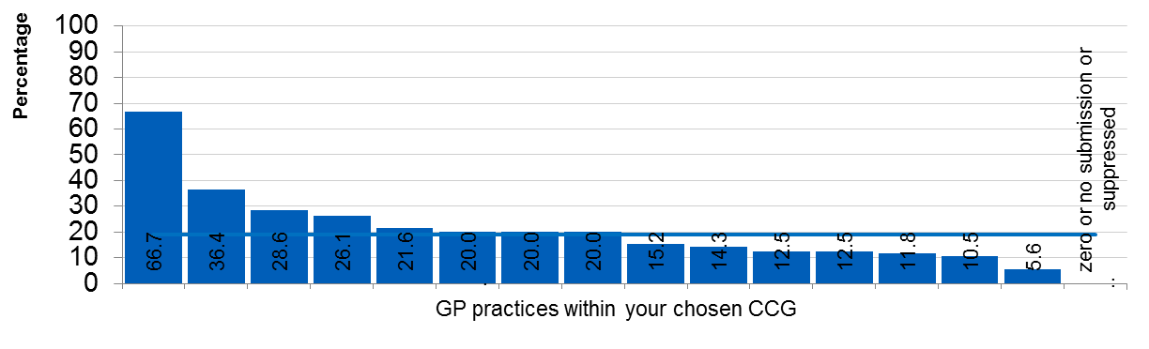
Treatment Targets – CCG/LHB information
This slide is for CCG/LHB or GP Practices to insert CCG/LHB or GP level information from the GP level excel spreadsheet.
For example:
You may choose to show Figure 4 from the TargetAchievement tab in the CCG Level spreadsheet. This will provide you with the spread of GP performance across a particular CCG.

Slide 33
Treatment Targets – Impact of Patient Characteristics
Key Finding
Statistical modelling has found that most of the variation seen in treatment target achievement cannot be explained by patient demographics.
Table 4: Selected characteristics and treatment target achievement for people with Type 2 diabetes in England and selected GP practices, 2015-2016 England
 | Type 2 and other diabetes patients
 | England | Dearden Avenue Medical Practice (P87625) | Highfields Surgery (C82116)
% of patients aged under 65 | 44.7 | 56.5 | 61.6
% of female patients | 44.4 | 46.0 | 49.5
% of patients living in more deprived areas* | 23.5 | 79.8 | 45.4
% of patients of non-white ethnic origin | 18.3 | 4.8 | 95.7
% achieving all three treatment targets | 40.4 | 58.3 | 63.7
Dearden Avenue Medical Practice in Salford CCG serves a relatively young population of patients with Type 2 and other diabetes, with a higher proportion of women patients than England as a whole. Both of these factors have some association with poorer treatment target achievement, however the practice is performing well. It also serves a more deprived population, although this has been found to have little association with achievement.
Highfields Surgery in Leicestershire City CCG also serves a relatively young, female population of people with Type 2 and other diabetes. Despite this, it has a higher achievement rate of patients meeting all three treatment targets. It also serves a relatively ethnically diverse and deprived population, although this has been found to have little association with achievement.

Slide 34
Treatment Targets – Impact of Patient Characteristics
Key Finding
Statistical modelling has found that most of the variation seen in treatment target achievement cannot be explained by patient demographics.
Table 5: Selected characteristics and treatment target achievement for people with Type 1 diabetes in England and a selected specialist service, 2015-2016
England
 | Type 1 diabetes patients
 | England | Manchester Royal Infirmary
% of patients aged under 65 | 85.8 | 92.9
% of female patients | 43.5 | 49.8
% of patients living in more deprived areas* | 19.5 | 29.1
% of patients of non-white ethnic origin | 8.1 | 14.4
% of patients achieving all three treatment targets | 18.3 | 21.5
Manchester Royal Infirmary serves a relatively young population of patients with Type 1 diabetes, with a higher proportion of women patients than England as a whole. Both of these factors have some association with poorer treatment target achievement, however the specialist service is performing well. It also serves a relatively ethnically diverse and deprived population, although this has been found to have little association with achievement.

Slide 35
Treatment Targets – Comments
Target achievement differences between CCGs/LHBs are substantial. Differences in patient demographics do not explain the extent of the variation.
Differences between specialist services and between general practices are substantial and the differences in patient demographics do not explain the extent of the variation.
Younger people are less often achieving treatment targets.
Changes that reduce variation and improve average achievement levels would yield great health benefits.
Recommendations
Commissioners:
  Support services that show they have challenges providing good outcomes
  Support trials of new approaches to care for younger people
Specialist and GP services:
  Benchmark against their peers using both local and national data
  Choose a priority for improvement
  Use the NDA QI guides to identify opportunities
  Implement improvement plans

Slide 36
National Diabetes Audit 2015-2016
Definitions, footnotes, data sources and further reading

Slide 37
Definitions
Diabetes
Diabetes is a condition where the amount of glucose in the blood is too high because the pancreas doesn’t produce enough insulin. Insulin is a hormone produced by the pancreas that allows glucose to be used as a body fuel and other nutrients to be used as building blocks. There are two main types of diabetes: Type 1 diabetes (no insulin); Type 2 diabetes (insufficient insulin)
Care Processes (NICE recommends all of these at least once a year)
Blood Pressure is a measurement of the force driving the blood through the arteries. Blood pressure readings contain two figures, e.g.130/80. The first is known as the systolic pressure which is produced when the heart contracts. The second is the diastolic pressure which is when the heart relaxes to refill with blood.
BMI measurement – Body Mass Index calculated from weight and height to classify under, normal and over-weight
Serum creatinine – this blood test is used as measure kidney function
Urinary albumin – this urine test detects the earliest stages of kidney disease
Cholesterol - this blood test measures a type of fat that can damage blood vessels
Foot check - this examination checks the blood supply and sensation (feeling) in the feet. Loss of either is a risk for foot disease
Smoking Status - this records whether the person is a smoker. Smoking increases the diabetic risk for heart attacks and stroke
HbA1c – this is a blood test for average blood glucose levels during the previous two to three months.

Slide 38
Definitions
Urine Albumin-to-Creatinine Ratio (UACR)
UACR is a ratio between two measured substances urine albumin and urine creatinine. Unlike a urine dipstick test for albumin, UACR is unaffected by variation in urine concentration.
Treatment Targets (NICE defines target levels to reduce risks of complications for people with diabetes)
HbA1c - the closer this is to normal (less than 42mmol/mol) the lower is the risk of all long term complications of diabetes
Cholesterol – reducing cholesterol levels lowers the risk of heart attacks and strokes
Blood Pressure – high levels are a risk for heart attacks and strokes; they also drive progression of eye and kidney disease
Specialist Service
This is a service (often hospital based but sometimes delivered in a community setting) which includes diabetes specialists working in multidisciplinary teams. These teams usually comprise physicians (diabetologists), diabetes specialist nurses and dieticians; it may also include clinical psychologists.

Slide 39
Footnotes
NICE recommended care processes http://www.nice.org.uk/guidance/conditions-and-diseases/diabetes-and-other-endocrinal--nutritional-and-metabolic-conditions/diabetes
National Service Framework (NSF) for Diabetes https://www.gov.uk/government/publications/national-service-framework-diabetes
NICE Clinical Guidelines – GN17: Type 1 diabetes in adults: diagnosis and management http://www.nice.org.uk/guidance/ng17
NICE Clinical Guidelines – NG28: Type 2 diabetes in adults: management http://www.nice.org.uk/guidance/ng28
NICE – Diabetes in Adults Quality Standard http://guidance.nice.org.uk/QS6
Type 2 diabetes includes people with Maturity-onset Diabetes of the Young (MODY), other and non specified diabetes type.
The eye screening care process is not included; therefore ‘eight care processes’ comprises of eight care processes excluding eye screening.

Slide 40
Additional information
The following documents are available from http://digital.nhs.uk/pubs/ndauditcorerep1516
Supporting data in Excel
  Supporting Information – National tables and charts
  Supporting information – Learning disability tables and charts
  CCG/GP practice level interactive spreadsheet
  LHB level interactive spreadsheet
  Specialist Service (England) interactive spreadsheet
  CCG/LHB level – All 8 care process completion and all 3 treatment target achievement by age group
PowerPoint version of this report
PowerPoint version of the learning disability supplementary report (including pdf version)
PowerPoint presentation giving an overview of the NDA programme
Data Quality Statement (pdf)
Methodology (pdf)

Slide 41
National Diabetes Audit
Report 1: Care processes and treatment targets, 2015-2016
Published by NHS Digital
Part of the Government Statistical Service
ISBN: 978-1-78386-931-2
For further information
digital.nhs.uk
0300 303 5678
enquiries@nhsdigital.nhs.uk
Copyright © 2017, the Healthcare Quality Improvement Partnership, National Diabetes Audit. All rights reserved.
This work remains the sole and exclusive property of the Healthcare Quality Improvement Partnership and may only be reproduced where there is explicit reference to the ownership of the Healthcare Quality Improvement Partnership.
This work may be re-used by NHS and government organisations without permission.

